Slide 1
… Lecture 10 … Mainly MCMC Models

Slide 2
… Lecture 10 … Mainly MCMC Models
Part 1:
The Bayesian Alphabet – up to C!

Slide 3

Factors for Accuracy
Phenotypes
Genetic
Architecture
Population
Genome
Structure
Genome Data
Heritability
(h²)
Number
Markers
(m)
Methodology
Number
Records
(N)
Marker
Selection
Accuracy

Slide 4
Genetic Architecture
Is number of loci small or very large?

Slide 5
Van Raden Model 1
Modelled the variance of allelic substitution
assumed MVN( 0, σ_{b}²I)
E[ variance contributed │LE, HWE ] = 2p_{j}(1-p_{j}) σ_{b}²
locus of intermediate frequency expected to contribute more variance than one of low MAF
‘given’, i.e. ‘conditional on’

Slide 6
Van Raden Model 1
Modelled the variance of allelic substitution
E[variance contributed │LE, HWE] = 2p_{j}(1-p_{j}) σ_{b}²
Frequency
Frequency
Approximately
~ 1/[p(1-p)]
MAF
MAF
SNP Chip
Sequence Data

Slide 7
Van Raden Model 1
Modelled the variance of allelic substitution
E[variance contributed │LE, HWE] = 2p_{j}(1-p_{j}) σ_{b}²
where does variance of trait reside in model?
Density of Total Variance
Density of Total Variance
MAF
MAF
SNP Chip
Sequence Data

Slide 8
Van Raden Model 2
Variance per locus was constant
Frequency
Frequency
Approximately
~ 1/[p(1-p)]
MAF
MAF
SNP Chip
Sequence Data

Slide 9
Van Raden Model 2
Variance per locus was constant
so variance in model follows SNP distribution
Density of Total Variance
Density of Total Variance
Approximately
~ 1/[p(1-p)]
MAF
MAF
SNP Chip
Sequence Data

Slide 10
More Models
What distribution of variance per locus?
Why is every locus expected to contribute?

Slide 11
Bayes A
Assume each SNP locus has a b_{j}
y ~ 1m + … + Xb + e as before
b_{j} now come from scaled t-distribution
not from N(0,σ_{b}²), i.e. scaled Mormal
t-distribution has ‘heavier tails’
‘shrinks small effects more than Normal’
‘shrinks large effects less than Normal’

Slide 12
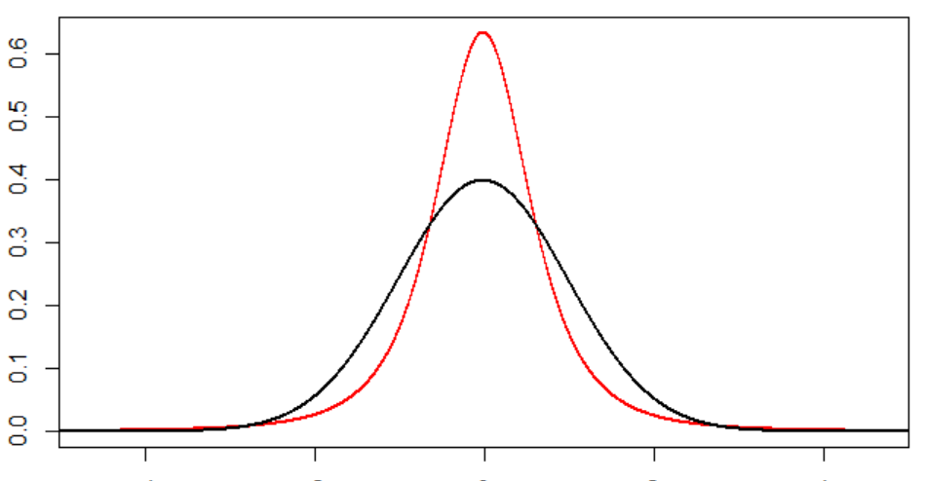
Bayes A
Assume each SNP locus has a b_{j}
y ~ 1m + Xb + e as before
b_{j} now come from t-distribution
not from N(0,σ_{b}²)
t-distribution has ‘heavier tails’
‘shrinks small effects more than Normal’
‘shrinks large effects less than Normal’

Slide 13
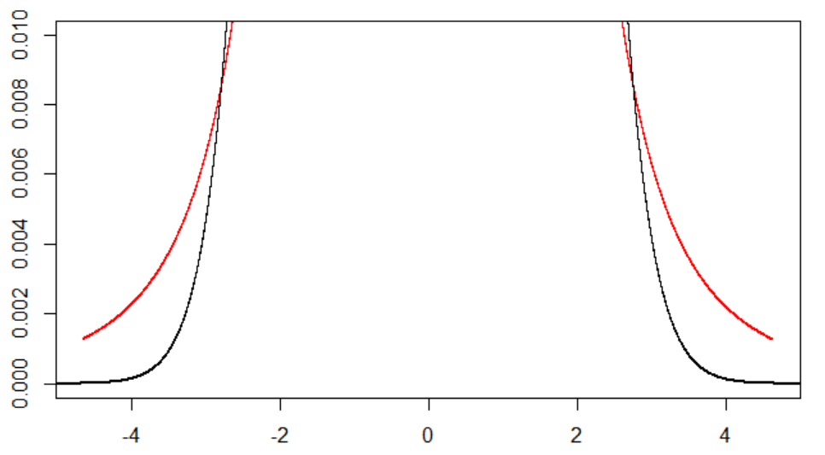
Bayes A
Assume each SNP locus has a b_{j}
y ~ 1m + Xb + e as before
b_{j} now come from t-distribution
not from N(0,σ_{b}²)
t-distribution has ‘heavier tails’
‘shrinks small effects more than Normal’
‘shrinks large effects less than Normal’

Slide 14
Bayes A
Assume each SNP locus has a b_{j}
y ~ 1m + Xb + e as before
b_{j} now come from t-distribution
not from N(0,σ_{b}²)
t-distribution has ‘heavier tails’
‘shrinks small effects more than Normal’
‘shrinks large effects less than Normal’
Kurtosis: platykurtic (light-tailed) or leptokurtic (heavy-tailed) c.f. Normal

Slide 15
Bayes B
Assume some SNP have no effect
say fraction π, pre-determined
Other (1-π) have effects
distributed as Bayes A with scaled t-distribution

Slide 16
Bayes C
Assume some SNP have no effect
say fraction π, pre-determined
Other (1-π) have effects
distributed as Normal
i.e. NOT t-distribution

Slide 17
Bayes Cπ
Assume some SNP have no effect
say fraction π
π ~ Uniform[0,1]
i.e. estimate π
Other (1-π) have effects
distributed as Normal
i.e. NOT t-distribution

Slide 18
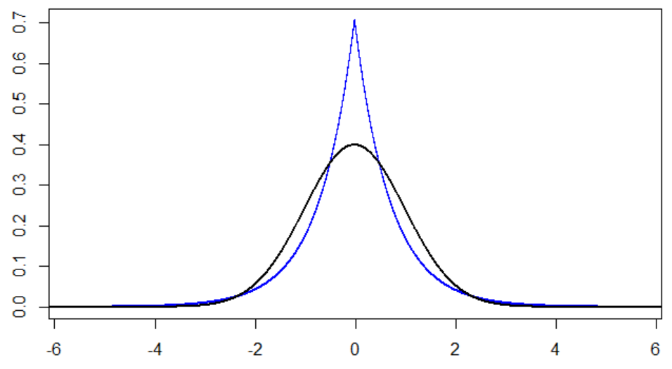
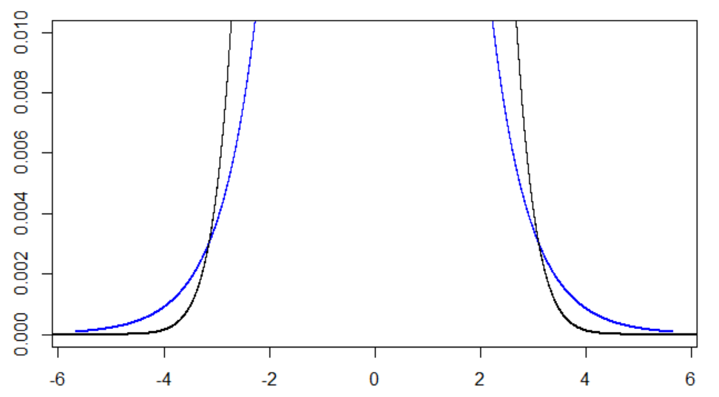
Bayesian Alphabet
Such models have proliferated!
e.g. Laplace …
Common theme
reduce shrinkage of apparently large effects
QTL hypothesis

Slide 19
Bayes Alphabet
Now have priors on
fractions of marker loci having an effect
distributions of marker effects or variance
forms of subset selection
identifying subsets with small or large effects
The priors on distributions result in shrinkage
priors are random distributions on marker effects
functional form of shrinkage depends on the prior

Slide 20
Bayes Alphabet
Models are simple to write down - but complex to solve!
Use Monte Carlo Markov Chains
MCMC
can be applied if one can write down the conditional distributions

Slide 22
… Lecture 10 … Mainly MCMC Models
Part 2:
‘The Cat at Christmas’ or ‘It’s a Cat’s Life’

Slide 23
Markov Chain Example
Suppose I have a cat
cat is either indoors or outdoors all day & night
cat may move indoors/outdoors only when I leave for work and remains until next morning
what happens depends on where I find the cat
the transitions are constant over time
 |  | From
 |  | Cat is Outside | Cat is Inside
To | Cat is Outside | 0.8 | 0.4
 | Cat is Inside | 0.2 | 0.6

Slide 24
Markov Chain Example
I have defined the conditional distributions
P[ Inside at t+1 │Inside at t ] = 0.6
P[ Outside at t+1│Inside at t ] = 0.4
can define conditional distribution if ‘Outside at t’
i.e. given any current state I can define the full conditional distribution for moving to another
 |  | From
 |  | Cat is Outside | Cat is Inside
To | Cat is Outside | 0.8 | 0.4
 | Cat is Inside | 0.2 | 0.6

Slide 25
It’s A Cat’s Life
What is the probability that on Christmas Day the cat will be inside?
I can solve by some fancy maths!
 |  | From
 |  | Cat is Outside | Cat is Inside
To | Cat is Outside | 0.8 | 0.4
 | Cat is Inside | 0.2 | 0.6

Slide 26
It’s A Cat’s Life
What probability that on Christmas Day the cat will be inside?
I can also solve by sampling random numbers
Monte Carlo Markov Chain (MCMC)
 |  | From
 |  | Cat is Outside | Cat is Inside
To | Cat is Outside | 0.8 | 0.4
 | Cat is Inside | 0.2 | 0.6

Slide 27
It’s A Cat’s Life
Start by assuming an S(0), say ‘In’
Draw random number X in U[0,1]
if ‘In’ & X ≤ 0.6, stay ‘In’, else ‘Out’
if ‘Out’ & X ≤ 0.2, go ‘In’, else stay ‘Out’
If done, say, 1000 times, stop, else go to 2
 |  | From
 |  | Cat is Outside | Cat is Inside
To | Cat is Outside | 0.8 | 0.4
 | Cat is Inside | 0.2 | 0.6

Slide 28
It’s A Cat’s Life
Initial values will depend on starting point
After a while influence of S(0) decays, burn-in
Then sequence is sample from an equilibrium
Look at how frequent ‘In’ occurs in sample
This is the probability of being ‘In’ on 25/12
 |  | From
 |  | Cat is Outside | Cat is Inside
To | Cat is Outside | 0.8 | 0.4
 | Cat is Inside | 0.2 | 0.6

Slide 29
It’s A Cat’s Life

Slide 30
It’s A Cat’s Life
 | Burn In | 0 | 10 | 20 | 30 | 40 | 50 | 60 | 70 | 80 | 90
1
2
3
4
5
6
7
8
9
10
 |  | From
 |  | Cat is Outside | Cat is Inside
To | Cat is Outside | 1, 2, 3, 4, 5, 6, 7, 8 | 1, 2, 3, 4
 | Cat is Inside | 9, 10 | 5, 6, 7, 8, 9, 10

Slide 31
It’s A Cat’s Life
Our answer is 0.33
Analytical answer is 1/3!
MCMC with 100,000 estimate is 0.3342
s.e. ~ 0.0039

Slide 32
… Lecture 10 … Mainly MCMC Models
Part 3:
MCMC & the amazing Ergodic Theorem!

Slide 33
Monte Carlo Markov Chains
Have n states that describe the problem
2 in cat example
Have complete set of conditional distributions
what are the probabilities of the next state given where I am now
Can obtain the distribution of solution
FROM
 | Cat is Outside | Cat is Inside
Cat is Outside | 1 to 8 | 1 to 4
Cat is Inside | 9 to 10 | 5 to 10
TO

Slide 34
Monte Carlo Markov Chains
Can go from 2 to n states S₁, S₂ … S_{n}
if we can define P[S(t+1)=S_{i}│S(t)=S_{j}] = c_{ij}
for all i and j, c_{ij} remains constant over time
e.g.
FROM
 | Cat is Absent | Cat is Outside | Cat is Inside
Cat is Absent | 0 | 0.05 | 0.10
Cat is Outside | 1 | 0.35 | 0.50
Cat is Inside | 0 | 0.60 | 0.40
TO

Slide 35
Monte Carlo Markov Chains
Can go from 2 to n states S₁, S₂ … S_{n}
if we can define P[S(t+1)=S_{i}│S(t)=S_{j}] = c_{ij}
for all i and j, c_{ij} remains constant over time
the c_{ij} are conditional probabilities … ‘probability of moving to i given now in j ’
i.e. can write down conditional distributions for moving from one state to another

Slide 36
Monte Carlo Markov Chains
Can go from 2 to n states S₁, S₂ … S_{n}
if we can define P[S(t+1)=S_{i}│S(t)=S_{j}] = c_{ij}
for all i and j, c_{ij} remains constant over time
the c_{ij} are conditional probabilities … ‘probability of moving to i given now in j ’
i.e. we can write down the conditional distributions for moving from one state to another
Can use Monte Carlo Markov Chains
can find probabilities of states from ‘stationary’ distribution

Slide 38
Continuous Variables
Observe data y
Model y with parameters u
u will have prior distributions, θ(u)
Can consider posterior distribution of u given (conditional on) y and priors θ(u)
Our states become all possible values of u
Infinite number of states as u continuous
Solution is probability distribution (density) over all the states
We are now in Bayesian Statistics!

Slide 39
Continuous Variables
Observe data y
Model y with parameters u
u will have prior distributions, θ(u)
Can consider posterior distribution of u given (conditional on) y and priors θ(u)
Our states become all possible values of u
Infinite number of states as u continuous
Solution is probability distribution (density) over all the states

Slide 40
The (Amazing) Ergodic Theorem
If I have data y … continuous or categorical
List parameters u = u₁, u₂ … u_{n} with data y
Write down all conditional distributions
i.e. u_{i} │u₁, u₂ …u_{i-1}, u_{i+1}, u_{n}, y for all i, and priors θ()
Find some starting values, u⁰, say u₁⁰, u₂⁰ … u_{n}⁰
Sample from conditional distributions e.g. if n=3
u¹ = (u₁¹ │u₂⁰, u₃⁰, y), (u₂¹ │u₁¹, u₃⁰, y), (u₃¹ │u₁¹, u₂¹, y)

Slide 41
The (Amazing) Ergodic Theorem
If I have data y … continuous or categorical
List parameters u = u₁, u₂ … u_{n} with data y
Write down all conditional distributions
i.e. u_{i} │u₁, u₂ …u_{i-1}, u_{i+1}, u_{n}, y for all i, and priors θ()
Find some starting values, u⁰, say u₁⁰, u₂⁰ … u_{n}⁰
Sample from conditional distributions e.g. if n=3
u¹ = (u₁¹ │u₂⁰, u₃⁰, y), (u₂¹ │u₁¹, u₃⁰, y), (u₃¹ │u₁¹, u₂¹, y)
Repeat Step 4, using u^{t} to get u^{t+1} … to large t

Slide 42
Example (Step 1)
Breeding values of 11 individuals, u_{a}, u_{b} … u_{k}
8 known without error , 3 unknown parameters
also assume V_{A} =1, known without error & infinitesimal model
how likely is ‘k’ best breeding value?
0.80 0.64 -0.77 ? ? 0.70
seed 7803260
-0.17 -1.01 0.56 0.15 ? from Schaeffer
a
b
c
d
e
f
g
h
i
j
k

Slide 43
Example (Step 2)
Conditional distributions
on all other parameters, assuming they are known
depend on only on parents, mates and offspring
u_{d} given {u_{a},…u_{c}, u_{e},…u_{k},V_{A}} is N(-0.27 +0.5u_{k}, 0.5)
u_{e} given {u_{a},…u_{d}, u_{f},…u_{k},V_{A}} is N(-0.95, 0.5)
u_{k} given {u_{a},…u_{j},V_{A}} is N( 0.35 +0.5u_{d}, 0.5)
a
b
c
d
e
f
g
h
i
j
k

Slide 44
Example (Step 3)
Starting values u⁰ is MVN(0, 0.7I₃) for unknown parameters
a
b
c
d
e
f
g
h
i
j
k

Slide 45
The (Amazing) Ergodic Theorem
If I have data y … continuous or categorical
List parameters u = u_{1,} u₂ … u_{n} with data y
Write down all conditional distributions
i.e. u_{i} │u₁, u₂ …u_{i-1}, u_{i+1}, u_{n}, y for all i
Find some starting values, u⁰, say u₁⁰, u₂⁰ … u_{n}⁰
Sample from conditional distributions e.g. if n=3
u¹ = (u₁¹ │u₂⁰, u₃⁰, y), (u₂¹ │u₁¹, u₃⁰, y), (u₃¹ │u₁¹, u₂¹, y)
Repeat Step 4, using u^{t} to get u^{t+1} … to large t
u^{t} is sample of posterior distribution u given y
for t > t_{burn-in} i.e. for large enough t

Slide 46
Example
Breeding values of 11 individuals, u_{a}, u_{b} … u_{k}
8 known without error , 3 unknown parameters
also assume V_{A} =1, known without error & infinitesimal model
how likely is ‘k’ best breeding value?
0.80 0.64 -0.77 ? ? 0.70
seed 7803260
-0.17 -1.01 0.56 0.15 ? from Schaeffer
a
b
c
d
e
f
Answer 0.64
g
h
i
j
k

Slide 47
The (Amazing) Ergodic Theorem
Can calculate summaries from posterior…
e.g. sample mean is parameter estimate
e.g. sample s.d. is measure of uncertainty
e.g. distribution of f(u) for any function f

Slide 48
The (Amazing) Ergodic Theorem
Can solve complex models by defining all conditional distributions u_{i} │u₁, u₂ …u_{i-1}, u_{i+1}, u_{n}, y
Must ensure stationarity (c.f. convergence)
posterior does not depend on starting values
all regions of posterior distribution explored
more parameters, more cycles
‘mixing speed’ slow for genotypes
Time = # parameters x # cycles x ‘unit cpu’
cycle number is large … say multiples of 10,000!

Slide 49
The (Amazing) Ergodic Theorem
Sampling procedure used was ‘Gibbs Sampling’
u^{t+1} = (u₁^{t+1} │u₂^{t}, u₃^{t}, y), (u₂^{t+1} │u₁^{t+1}, u₃^{t}, y), (u₃^{t+1} │u₁^{t+1}, u₂^{t+1}, y)
slow
more complex procedures can speed mixing and stationarity
Generally, need to sample from many different distributions
e.g. priors on variances are ‘inverse chi-squared’
avoided in example by assuming V_{A} known, i.e. Prob(V_{A}=1) = 1
Use of ‘uninformative priors’
how much have the priors influenced the results

Slide 50
‘Bayesian Methods’ & MCMC
Bayesian Methods do not require MCMC
MCMC makes complex models feasible
Data y
Parameterised model
with ‘priors’ on parameters
MCMC
‘Posterior’ distributions
for parameters
conditional on y
Thomas Bayes studied Logic & Theology,
University of Edinburgh 1719-1722!

Slide 51
MCMCglmm
R package
by Jarod Hadfield
use for Blue Tit data in Tutorial 10!

Slide 52
… Lecture 10 … Mainly MCMC Models
Part 4:
Back to the Bayesian Alphabet

Slide 53
Bayesian Alphabet
Bayes A, B, C, … can be solved using MCMC
as we can write down all conditional distributions
and sample from them
computationally snail-paced c.f. GBLUP
there are fast ‘approximate’ algorithms

Slide 54
Factors for Accuracy
Phenotypes
Genetic
Architecture
Population
Genome
Structure
Genome Data
Heritability
(h²)
Number
Markers
(m)
Methodology
Number
Records
(N)
Marker
Selection
Accuracy

Slide 55
Bayesian Methods
Bayesian methods can put prior on numbers of contributing loci
e.g. Bayes B
When better than GBLUP?
GBLUP treats as if Me ‘loci’
‘number of beans in bean bag’
prior useful if # QTL less than Me
best evaluation method depends on population genome
i.e. ‘number of beans in population’s bean bag’

Slide 56
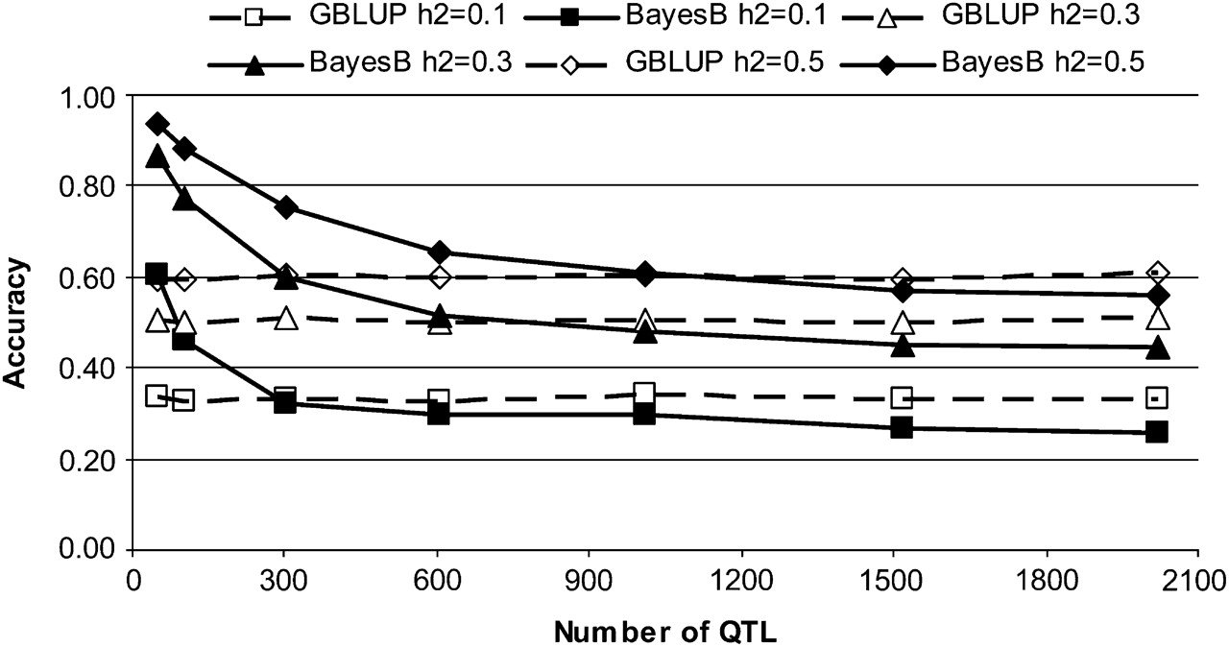




Accuracy as f(#QTN)
Correlation with TBV
QTNs in data, ‘sequence-ready’; N_{e} =1000, L=10M, N=1000
From Daetwyler et al. 2010

Slide 57
Bayesian Alphabet
Early simulations always had few QTN cf M_{e}
Always found BayesB better!
Practical cattle data had no benefit of BayesB
Relative merit of method depends on species
dairy cattle, low N_{e}, GBLUP as good
medical, high N_{e}, BayesB-type more likely a benefit
however need to compute!
Changing distributions has only small effect

Slide 59
… Lecture 10 … Mainly MCMC Models
Part 5:
QG Revisited & the Impact of Genomics

Slide 60
Breeding Limitations
Sex-limited
Age-limited
Destructive traits

Slide 61
Salmon Breeding: Example
Important objective is disease resistance
Candidates must be free of disease
Large full-sib families, each generation
split into two populations
one for breeding
one for exposing to pathogens & recording mortality
Notes:
61

Slide 62
Salmon Breeding: Example
Selection on own growth and family mean disease resistance
individuals are ‘only as good as their family’
cannot distinguish full-sibs on disease resistance
promotes inbreeding
Disease Challenge
Growth on Candidates
Notes:
62

Slide 63
Salmon Breeding: Example
‘Within-family’ genomic selection among sibs
obtain accurate Mendelian estimates if large
allows selection on individual merit within families
even for disease
reduces reliance on pedigrees
Disease Challenge
Growth on Candidates

Slide 64
Prior to Genomics & OC
Selective advantage of truncation selection relied on EBV
EBVs relied on pedigree
used information on relatives to ↑ accuracy
often ancestral information via sire and dam
Family background has major role in selection

Slide 65
Optimum Contributions (OC)
Long-term contribution
Predicted Mendelian Sampling Term
Notes:
In practice, because we can’t change the contribution of an ancestor with out affecting the contribution of other individuals in the population e.g. its parents, we can only aspire to the target and aim to get as close as possible. Remember long-terms are not determined in a single generation and so each selection decision is effectively trying to manage the contributions of all individuals in the population simultaneously. Furthermore each generation we get more information on an individuals breeding value so it will change over time (the changes diminishing over time).

Slide 66
Genomic Evaluation & OC
ΔG arises by promoting best Mendelian terms
Optimum contributions maximise ΔG for ΔF
Selective advantage of OC is estimated Mendelian term
merit unique to the individual
Genomic selection increases accuracy of selective advantage of OC
Genomic selection will ↑ ΔG at same ΔF

Slide 67
Conclusion
From aristocracy to meritocracy the (genomic) revolution is coming!
(I still hope)

